Slide 1
Network Protocols & Security
[22EC2210R]
CO-1
Error Detection

Slide 2
AIM OF THE SESSION
The aim of the module on Error Detection in Computer Networks is to provide students with a comprehensive understanding of error detection techniques and protocols used in computer networks. The module aims to equip students with the knowledge and skills necessary to detect and handle errors that occur during data transmission, ensuring data integrity and reliability in network communication.
INSTRUCTIONAL OBJECTIVES
Understand the concept of error detection and its importance in computer networks.
Learn the principles and mechanisms of common error detection techniques, such as parity checking, checksums, and cyclic redundancy check (CRC).
Identify the limitations and strengths of different error detection techniques and protocols.
Apply error detection techniques in practical scenarios, including data transmission over different network protocols.
Analyze the impact of errors on network performance and the importance of error detection in ensuring reliable data communication.
LEARNING OUTCOMES
By the end of the module on Error Detection in Computer Networks, students will be able to:
Understand the concept of error detection and its significance in network communication.
Implement error detection techniques, such as parity checking, checksums, and CRC, to detect errors in data transmission.
Evaluate the strengths and limitations of different error detection techniques and protocols.
Analyze the impact of errors on network performance and propose appropriate error detection mechanisms based on specific network requirements.

Slide 3
AGENDA
Errors
Types of Errors
Error Detection
Block Coding
Parity Check
Cyclic Redundancy Check
Checksum

Slide 4
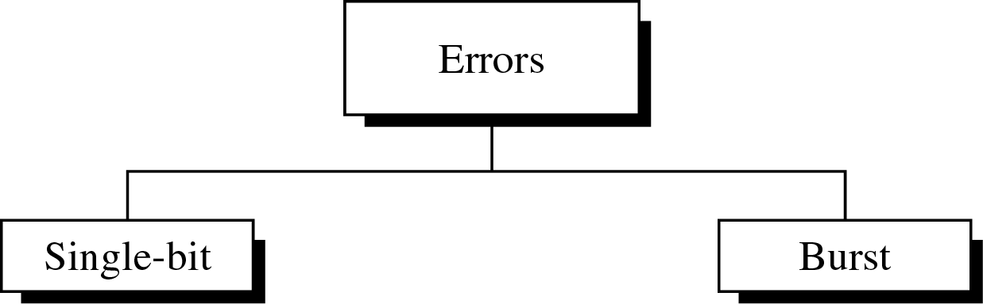
Type of Errors
Error Detection
Data can be corrupted during transmission. For reliable communication, error must be detected and corrected
Error Detection and Correction are implemented either at the data link layer or the transport layer of the OSI model

Slide 5
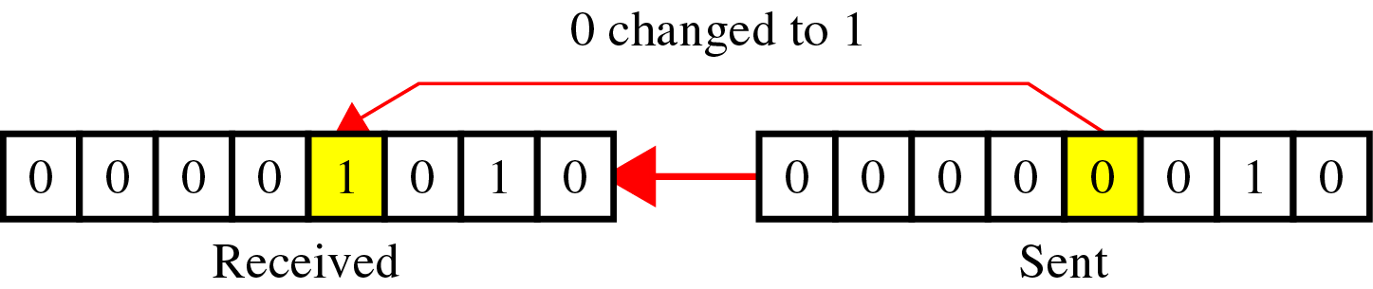
Type of Errors(cont’d)
Single-Bit Error
is when only one bit in the data unit has changed (ex : ASCII STX - ASCII LF)

Slide 6
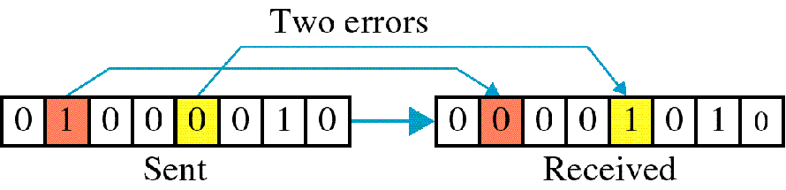
Type of Errors(cont’d)
Multiple-Bit Error
is when two or more nonconsecutive bits in the data unit have changed(ex : ASCII B - ASCII LF)

Slide 7
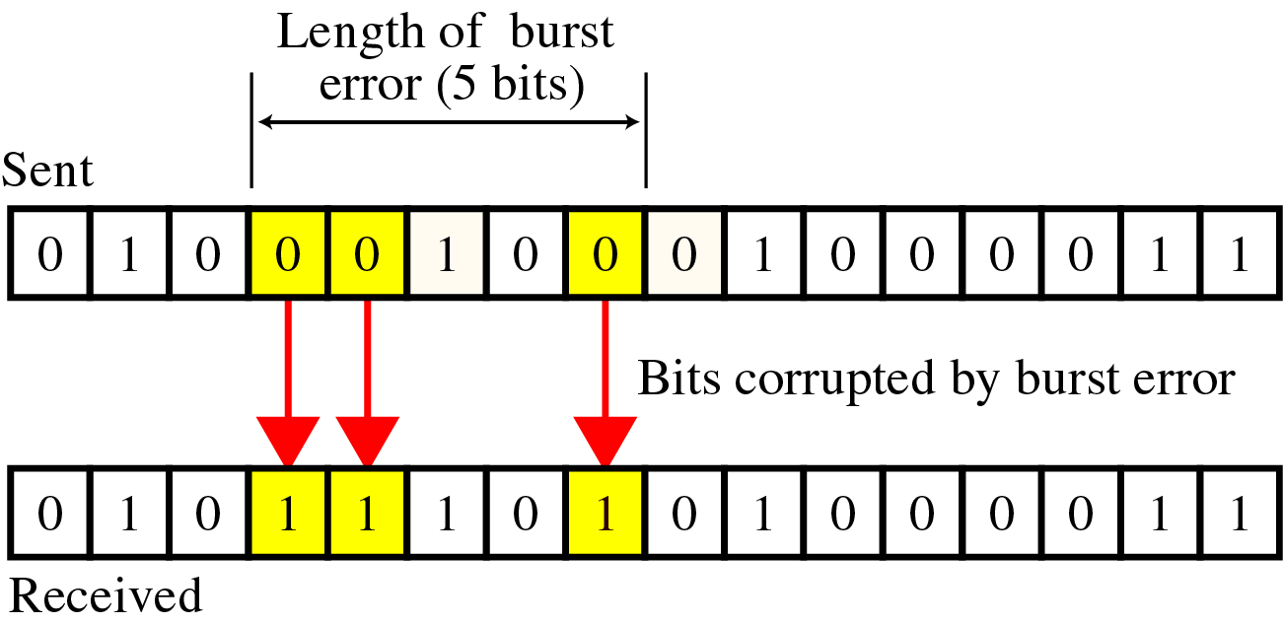
Type of Errors(cont’d)
Burst Error
means that 2 or more consecutive bits in the data unit have changed

Slide 8
Detection
Error detection uses the concept of redundancy, which means adding extra bits for detecting errors at the destination

Slide 9
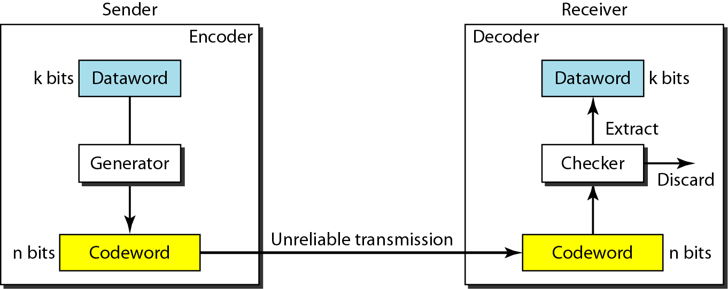
The structure of encoder and decoder
To detect or correct errors, we need to send redundant bits

Slide 10
BLOCK CODING
In block coding, we divide our message into blocks, each of k bits, called datawords. We add r redundant bits to each block to make the length n = k + r. The resulting n-bit blocks are called codewords.

Slide 11
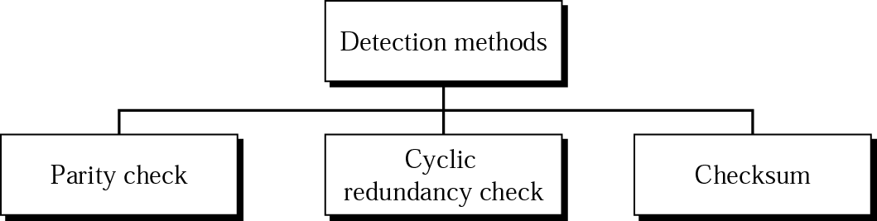
Detection(cont’d)
Detection methods

Slide 12
Detection -examples
Example 1
Suppose the sender wants to send the word world.
In ASCII the five characters are coded as
1110111 1101111 1110010 1101100 1100100
The following shows the actual bits sent
11101110 11011110 11100100 11011000 11001001

Slide 13
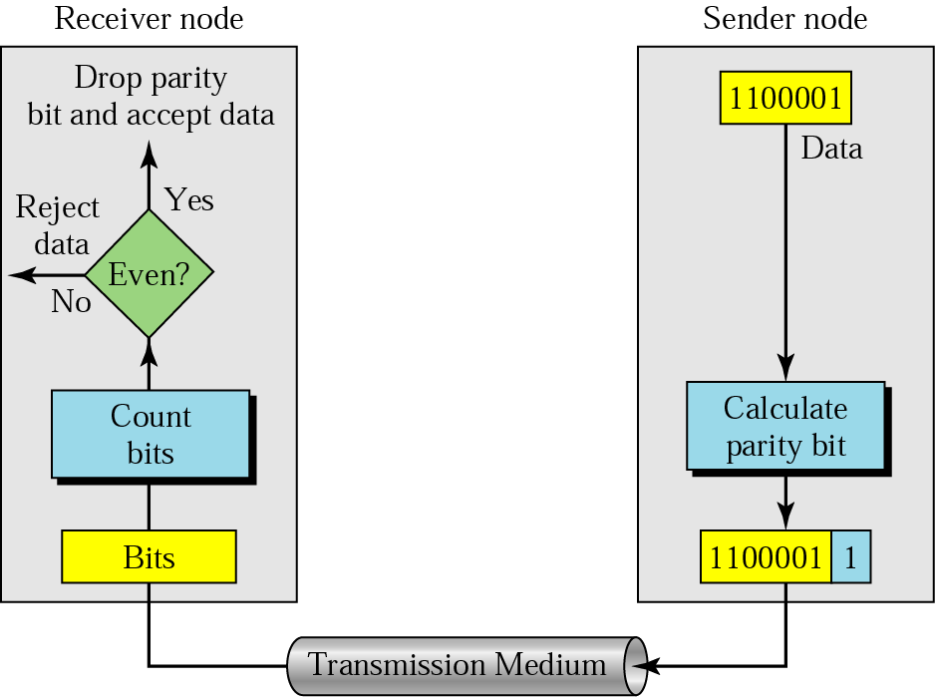
Detection(cont’d)
Parity Check
A parity bit is added to every data unit so that the total number of 1s(including the parity bit) becomes even for even-parity check or odd for odd-parity check
Simple parity check

Slide 14
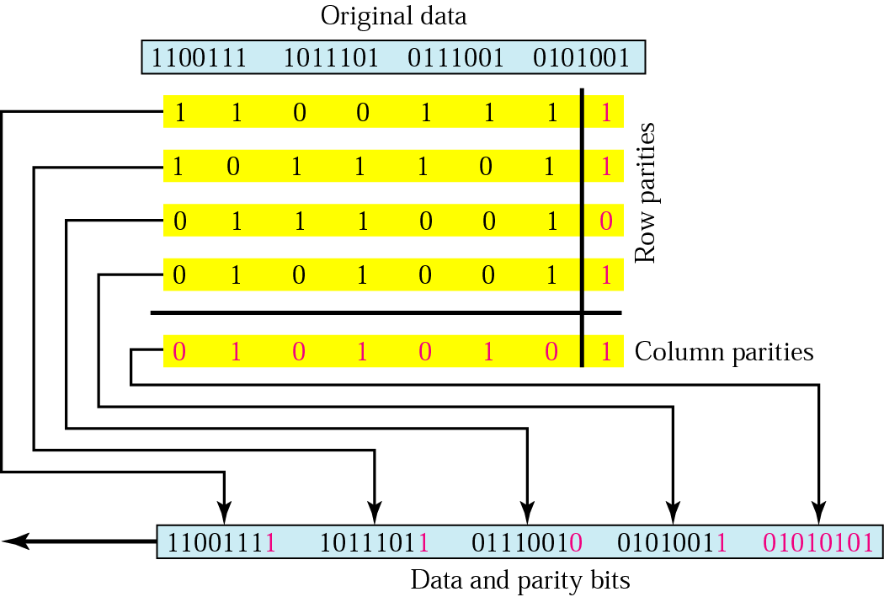
Two –Dimensional Parity Check

Slide 15
Detection -examples
Example 2
Now suppose the word world in Example 1 is received by the receiver without being corrupted in transmission.
11101110 11011110 11100100 11011000 11001001
The receiver counts the 1s in each character and comes up with even numbers (6, 6, 4, 4, 4). The data are accepted.

Slide 16
Detection -examples
Example 3
Now suppose the word world in Example 1 is corrupted during transmission.
11111110 11011110 11101100 11011000 11001001
The receiver counts the 1s in each character and comes up with even and odd numbers (7, 6, 5, 4, 4). The receiver knows that the data are corrupted, discards them, and asks for retransmission.

Slide 17
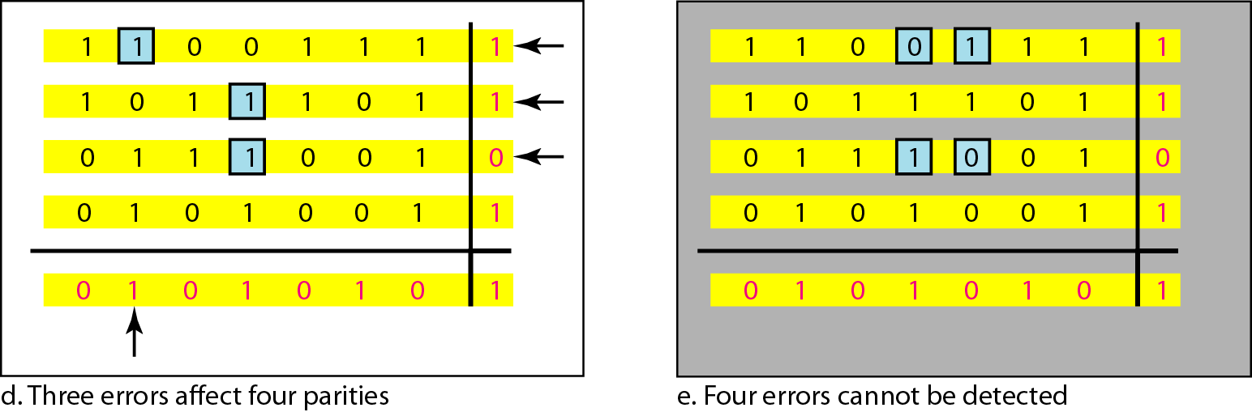
Two-dimensional parity-check code

Slide 18
Cyclic Redundancy Check (CRC):
We can create cyclic codes to correct errors.
Suppose Data word is of length k and Code word is of n length, then n-k 0’s are to be added to the dataword
If data word is of k length and generator(n-k+1) has been given then first find n and then n-k 0’s are to be added to the dataword (redundant bits)

Slide 19
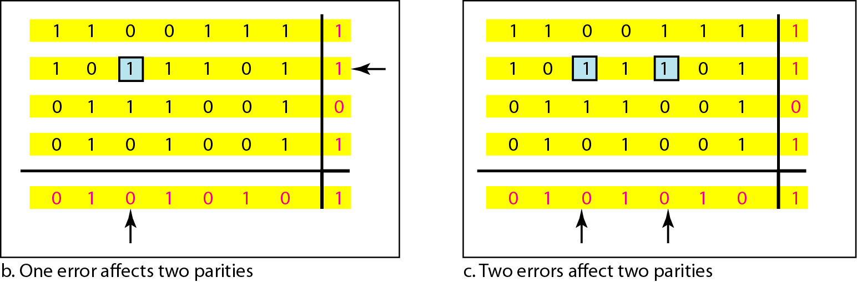
Two-dimensional parity-check code

Slide 20
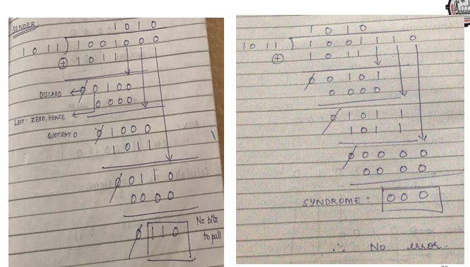

Slide 21
Example-1: Consider the message M=1001 and do the Cyclic Redundancy check for the above message using the following divisor 1011. Also check for errors on the received data using CRC.
Sol: Given Dividend = 1001 ( k = 4) and Divisor = 1011 (n-k+1)
given n – k + 1 = 4 , first we need to find n and then calculate redundant bits
n – k + 1 = 4
n – 4 + 1 = 4
n = 7
if n = 7 then no of redundant bits = n – k = 7 – 4 = 3
so we need to add three 0’s to the data word

Slide 22
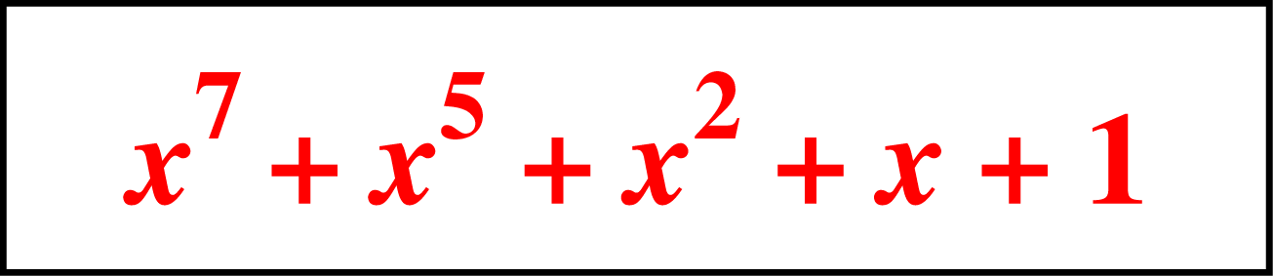
Detection(cont’d)
Polynomials
CRC generator(divisor) is most often represented not as a string of 1s and 0s, but as an algebraic polynomial.

Slide 23
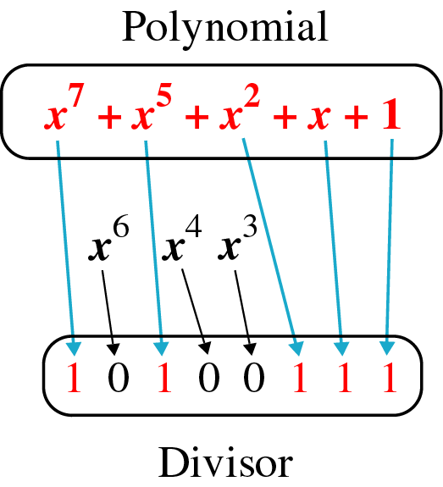
Detection(cont’d)
A polynomial representing a divisor

Slide 24
Example-3: The message 1101011011 is to be transmitted using the generator polynomial x⁴+ x + 1 to protect it from errors. Find the final data to be transmitted after performing CRC.
Example-4: M(x) = X³ + 1 and G(x) = X³ + x + 1
Sol: Given data word as M(x) = X³ + 1
To obtain code word, multiply M(x) by X³ (highest power of G(x))
so, C(x) = X³ (X³ + 1) = X⁶ + X³
Then divide C(x) with G(x) to obtain remainder

Slide 25
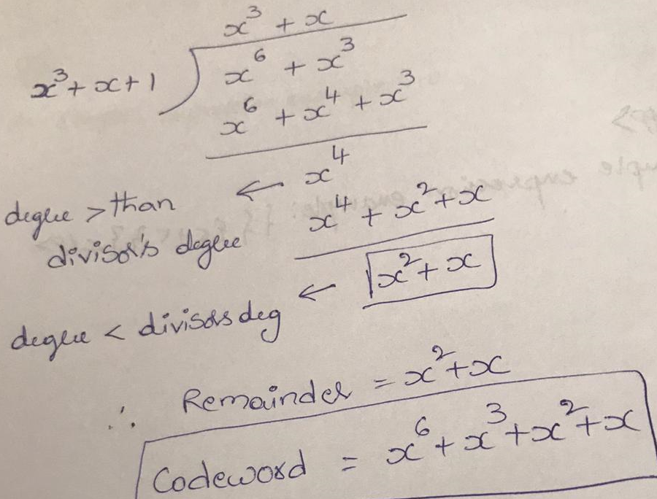
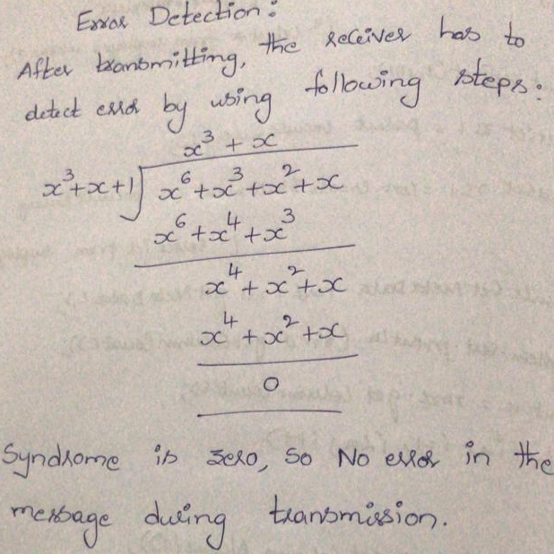

Slide 26
Detection(cont’d)
Checksum
Like the parity checks and CRC, the checksum is based on the concept of redundancy.
Checksum Generator
Checksum Generator subdivides the data unit into equal segments of n bits.
The segments are added using ones complement arithmetic in such a way that the total is also n bits long.
The total is then complemented and appended to the end of the original data unit as redundant bits, called checksum field.
The extended data unit is transmitted across the network.
If the sum of the data segment is T, the checksum will be -T

Slide 28
Detection(cont’d)
Example ( at a sender)
Original data : 10101001 00111001
10101001
00111001
--------------
11100010 Sum
00011101 Checksum
10101001 00111001 00011101

Slide 29
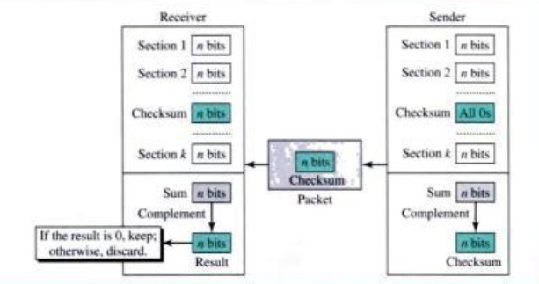

Detection(cont’d)
Checksum Checker
The receiver subdivides the data unit received into k sections, each of n bits
All the sections are added using ones complement to get the sum
The sum is complemented
If the result is zero, the data are accepted; otherwise, they are rejected

Slide 30
Detection(cont’d)
Example ( at a receiver)
Received data : 10101001 00111001 00011101
10101001
00111001
00011101
---------------
11111111 ← Sum
00000000 ← Complement
Example-2: original data is 10110011 10101011 01011010 11010101. perform checksum to detect error.

Slide 31
SELF-ASSESSMENT QUESTIONS
What is the purpose of error detection in computer networks, and why is it important?
Explain the concept of parity checking and how it can be used for error detection.
What are checksums, and how are they calculated and verified for error detection?
Describe the principles of the cyclic redundancy check (CRC) algorithm and its role in error detection.
Compare and contrast the strengths and limitations of parity checking, checksums, and CRC for error detection.
How does Automatic Repeat Request (ARQ) work in error detection and correction? Explain different ARQ schemes.
How do errors in network communication impact network performance, and why is error detection crucial for reliable data transmission?

Slide 32
REFERENCES FOR FURTHER LEARNING OF THE SESSION
Reference Books:
1. Data Communications and Networking, Behrouz A. Forouzan, 4th Edition, McGraw Hill.
2. Computer Networks, Tanenbaum, 6th Edition, Pearson.
Sites and Web links:
CISCO Academy
NPTEL, Computer Networks and Internet Protocols, Prof. Soumya Kanti Ghosh, Prof. Sandip Chakraborty IIT Kharagpur. (https://nptel.ac.in/courses/106105183)

Slide 33

THANK YOU
Team – Networks Protocols & Security

